Slide 1
Elementary data organization
Data are simply values or sets of values. A single unit of value is called a Data item. Data items are divided into subgroups called Group items.
An Entity is something that has certain attributes which may be assigned values. An entity with similar attributes is called an Entity set.
Meaningful or processed data is called information. The collection of data is organized into the hierarchy of fields, records and files.
A single elementary unit of information representing an attribute of an entity is called a Field.
Records are the collection of field values of a given entity.
Collection of records of the entities in a given entity set is called a file.
Each record may contain a certain field that uniquely represents that record. Such a field K is called a primary key.
Ex:- Entity : Employee Attribute : Name , Age phone
Values : "ABC",42, 9847092568
Entity set : All employees in an organization.

Slide 2
Based on their length, records may be classified into two. They are, Fixed-length record : All record contain the same data items with the same amount of space assigned to each items. Variance length record: Records may contain different length data items. Definition of Data Structure “The logical or mathematical model of a particular organization of data is called a data structure.” The choice depends on two consideration. First, it must be rich enough in structure to mirror the actual relationship of the data in the real world. Also, the structure should be simple enough that one can effectively process the data when necessary.

Slide 3
Difference between Data Types & Data Structures
Data Types | Data Structures
Data Type is the kind or form of a variable which is being used throughout the program. It defines that the particular variable will assign the values of the given data type only | Data Structure is the collection of different kinds of data. That entire data can be represented using an object and can be used throughout the entire program.
Implementation through Data Types is a form of abstract implementation | Implementation through Data Structures is called concrete implementation
Can hold values and not data, so it is data less | Can hold different kind and types of data within one single object
Values can directly be assigned to the data type variables | The data is assigned to the data structure object using some set of algorithms and operations like push, pop and so on.
No problem of time complexity | Time complexity comes into play when working with data structures
Examples: int, float, double | Examples: stacks, queues, tree

Slide 4
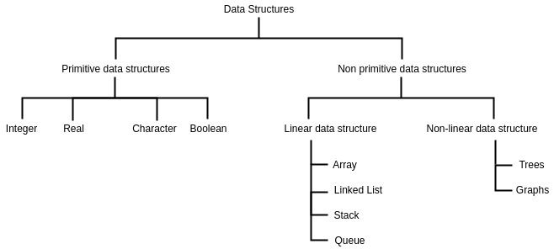
Categories of data structures Data structures are generally classified into primitive and non-primitive data structures. Different categories of data structures are shown in the figure.

Slide 5
Primitive data structures Basic data structures that cannot be further divided is called primitive data structures. Non primitive data structures Data structures that can be used for other complex storages are called non-primitive data structures. Non-primitive data structures are again classified as linear and non-linear data types. A data structure is said to be linear if its elements form a sequence. Data structures like Array, Stack, Queue and linked list organizes data in linear order. A non-linear data structure is one in which its elements are not arranged in sequence. Trees and graphs are widely used non-linear data structures. It represents a hierarchical relationship between individual data elements.

Slide 6
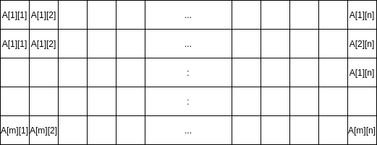
ARRAY A linear array or a one-dimensional array is the simplest type of data structure. It is a list of a finite number, n, of data elements of a similar type. These elements are represented by a set of consecutive numbers respectively. If A is the array name, then the array elements are represented as any of the following notations. A two-dimensional array is a collection of similar data elements where each element is referenced by two subscripts.

Slide 7
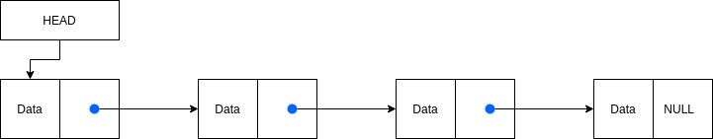
Linked lists A linked list is a collection of data elements whose order is not given by their physical location in memory. It consists of nodes that contain data and link to the next node. The structure allows easiness in insertion and deletion operations. The last nodes are linked to NULL and signify the end of the list.

Slide 8
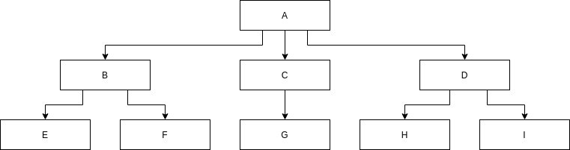
Trees Some data contains a hierarchical relationship between various elements. These data are represented in the form of a Rooted tree graph or simply Tree. Here node A is called the root of the tree.

Slide 9
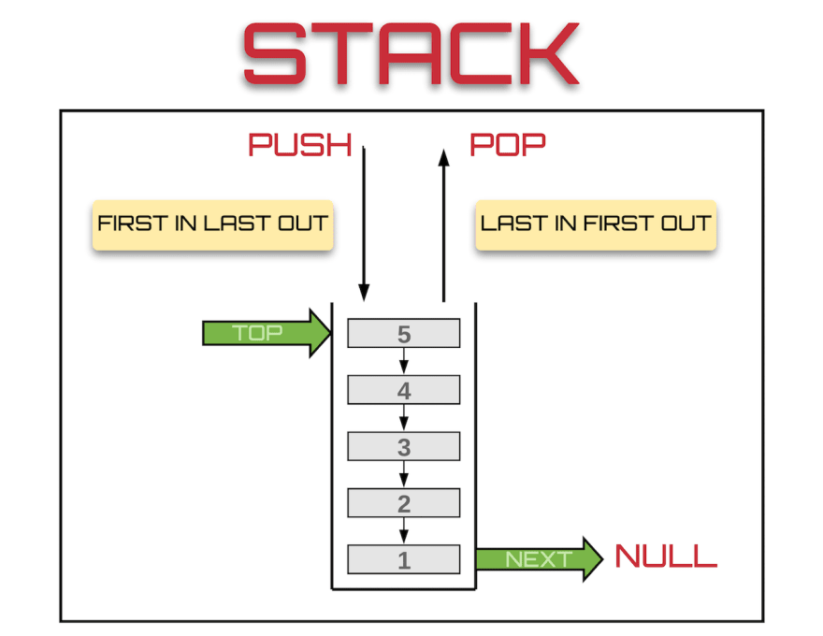
Stack Stack , LIFO(Last In First Out) system, is a linear data structure in which insertion(PUSH) and deletion(POP) are restricted to one endpoint called TOP.

Slide 10
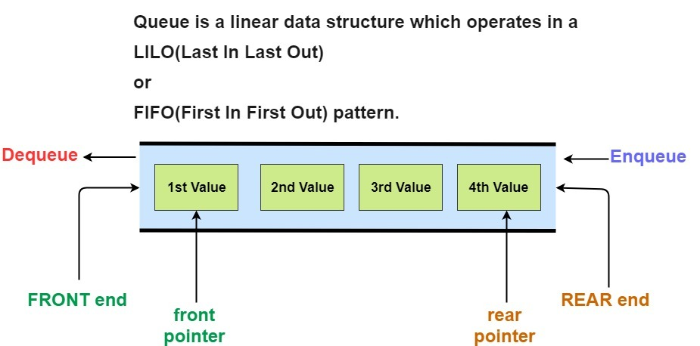
Queue A queue is a FIFO(First In First Out) system, in which insertion(ENQUEUE) can take place only at an end called REAR and deletion(DEQUEUE) can take place only at another end called FRONT.

Slide 11
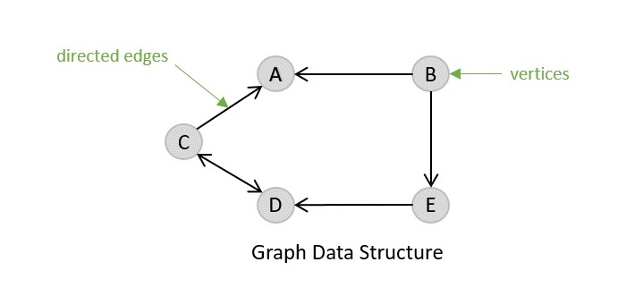
Graphs Sometimes data contain relationships that are not hierarchical in nature. This type of relationship can be expressed in the form of a graph data structure.

Slide 12
Data structure operations The data in the data structures are processed by certain operations. Traversing: Visiting each record so that items in the records can be accessed. Searching: Finding the location of the record with a given key or value or finding all records which satisfy given conditions. Inserting: Adding a new record to the data structure. Deleting: Removing records from the data structure. Sorting: Arranging records in some logical or numerical order. (Eg: Alphabetic order) Merging: Combing records from two different sorted files into a single file.

Slide 13
Applications of data structures Different types of data structures are used for different kinds of purposes. Some of them are highly specialized in specific tasks. Applications of data structures are listed below. Applications of Arrays 1.To implement mathematical vectors and matrices. 2.To model sets or collections in computer programming. 3.To implement other data structures such as lists, queues, stacks, and heaps. 4.Sometimes used to emulate in-program dynamic memory allocation. Applications of Linked lists 1.To implement other data structures such as queues, stacks,trees…etc 2.Used for dynamic memory allocation. 3.For manipulating polynomials, representing sparse matrices…etc 4.A doubly linked list can be used in navigation systems. 5.The doubly linked list is also used by various applications to implement Undo and Redo functionality.

Slide 14
Applications of Trees 1.To search for an element in a set quickly, Binary Search Trees(BSTs) are used. 2.Heap sort is done by a kind of tree called a Heap. 3.Tries are modified versions of trees used to store routing information in routers. 4.A compiler uses a syntax tree to parse the program you write. 5.Shortest path trees and spanning Trees are used in bridges and routers. Applications of Stacks The LIFO property of Stack can be useful in the following applications. 1.Evaluating Expressions. 2.Converting between expressions. 3.Backtracking. 4.Parsing context-free languages. 5.Recursion removal. 6.Tree and graph traversal.

Slide 15
Applications of Queues The following applications require FIFO storage and are implemented using Queues. 1.Manage resource sharing such as CPU scheduling, disk scheduling..etc 2.When data is sent and received between two processes not necessarily at the same rate. Applications of Graphs 1.Transportation networks like the one used by Google Maps. 2.Representation of molecular structure. 3.Finding the shortest path. 4.Airline network. 5.Social networks.

Slide 16
Algorithm complexity and time space trade off An algorithm is defined as a well-defined list of steps for solving a problem. Each step of an algorithm will have a clear meaning and can be performed with a finite amount of effort and finite length of time. Every algorithm must satisfy the following criteria, Inputs: Zero or more quantities which are externally supplied to the algorithm. Output: At least one quantity is produced as output. Definiteness: Each step must be clear and unambigous. Finiteness: All steps for all cases of an algorithm will terminate after a finite amount of time. Effectiveness: The algorithm will be efficient. The efficiency of an algorithm is measured in terms of the time and space it uses. The complexity of an algorithm is expressed as a function of input size which gives running time and or space.

Slide 17
Complexity Suppose M is an algorithm and suppose n is the size of the input data. The efficiency of M is measured in terms of time and space used by the algorithm. Time is measured by counting the number of operations and space is measured by counting the maximum amount of memory consumed by M. The complexity of M is the function f(n) which gives running time and or space in terms of n. In complexity theory, we find complexity f(n) for three major cases as follows, Worst case: f(n) have the maximum value for any possible inputs. Average case: f(n) have the expected value. Best case: f(n) have the minimum possible value.

Slide 18
space-time tradeoff Sometimes the choice of a data structure involves a space-time tradeoff. That is by increasing the amount of space for storing the data, we may be able to reduce the time needed for processing data or vice-versa

Slide 19
Big O Notation: Big O notation is a symbolism used in complexity theory to describe the asymptotic behavior of functions. Basically, it tells you how fast a function grows or declines. These are the mathematical notations that are used for the asymptotic analysis of the algorithms. The term 'asymptotic' describes an expression where a variable exists whose value tends to infinity. Thus, using asymptotic notations, we analyze the complexities of an algorithm and its performance. Using the asymptotic notations, we determine and show the complexities after analyzing it. Therefore, there are three types of asymptotic notations through which we can analyze the complexities of the algorithms:

Slide 20
Big O Notation (O): It represents the upper bound of the runtime of an algorithm. Big O Notation's role is to calculate the longest time an algorithm can take for its execution, i.e., it is used for calculating the worst-case time complexity of an algorithm. Omega Notation (Ω(n)): It represents the lower bound of the runtime of an algorithm. It is used for calculating the best time an algorithm can take to complete its execution, i.e., it is used for measuring the best case time complexity of an algorithm. Theta Notation (Θ(n)): It carries the middle characteristics of both Big O and Omega notations as it represents the lower and upper bound of an algorithm.

